Slide 1
COVID-19, 2020 ANALYSIS AND PREDICTION OF COVID-19 INFECTED.
September, 2020

Slide 2
This project is divided into two parts:
This section includes the analysis of history of covid-19 in which countries this pandemic started, count of covid-19 infected during the period from December 31st, 2019 to August 9th, 2020, fatality of this pandemic, strictness of lockdown, population density of the countries because it plays a major role in this spread, hand washing facilities and sanitary facilities, hospital facilities , etc,.
This section deals with the prediction of total covid-19 infected people in the upcoming 10 days by considering the infected graph for the past few months. Here ARIMA model is used for predicting the covid-19 infected people count.

Slide 3
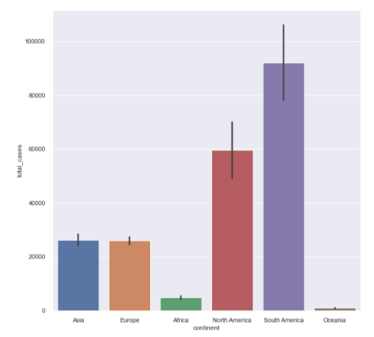
COVID-19 INFECTED CASES ACROSS CONTINENT
South America has more number of cases and next to it stands North America.
Africa as a under developed country and Oceania as a developed country have the least number of cases.
Both Asia and Europe have approximately same number of people affected with COVID-19.

Slide 4
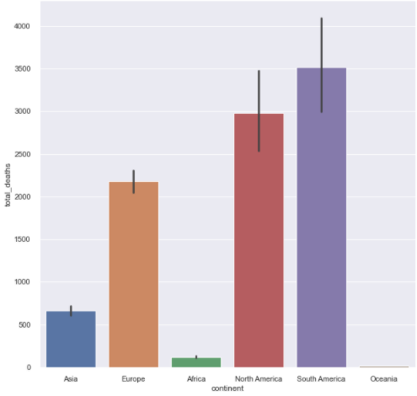
COVID-19 Deaths ACROSS CONTINENT
Same as the total number of cases South America have more number of deaths and next to it stands North America. When we do compare the infected graph with this fatality graph, we could observe the difference in deaths is slightly lesser than the difference in infected count.
Both Asia and Europe having the same amount of covid-19 cases the death rate is observed unambiguously higher in Europe than in Asia. Both countries having same no of covid-19 infected cases, it’s very shocking to see this graph having more deaths in Europe than Asia
Africa and Oceania have the least death rate. In Oceania almost the death rate is not visible.

Slide 5
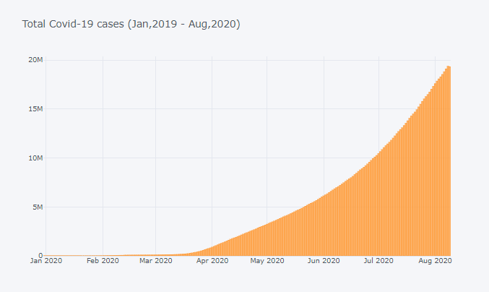
TOTAL COVID-19 INFECTED CASES
From this below image we can observe an increasing pattern in total covid-19 infected cases recorded from the month of January to August.
We can a see a marginal and gradual increasing pattern in the months of January and February, and from the middle of March the cases started to increase drastically.

Slide 6
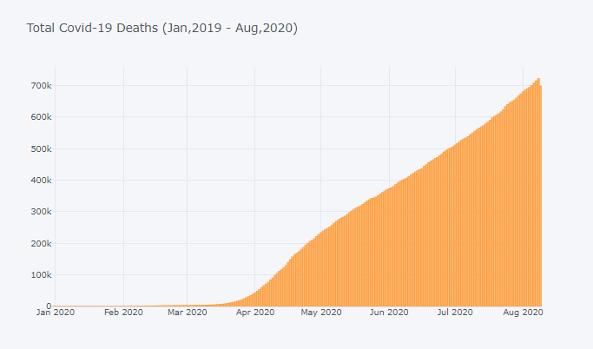
COVID FATALITIES
From the above image we can notice from the middle of March the death started to follow an increasing pattern and by the month of august, as of now the covid-19 death rate almost reached 721K which is very disappointing.
In the months of January and February the death rate is somewhat less somehow not all the people who are infected are dead even though there is no cure. Somewhat death rate is under control in the first two months of 2020.

Slide 7
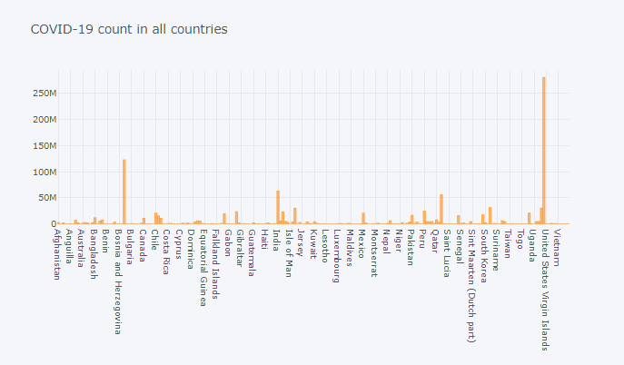
Covid-19 count across countries
From the above plot we can observe United States has more count almost 280 million covid-19 infected cases and Brazil having almost 122 million covid-19 cases is in second position in covid-19 infected cases as of now.
India and Russia stands next to that having almost around 65million infected and 60million respectively.

Slide 8
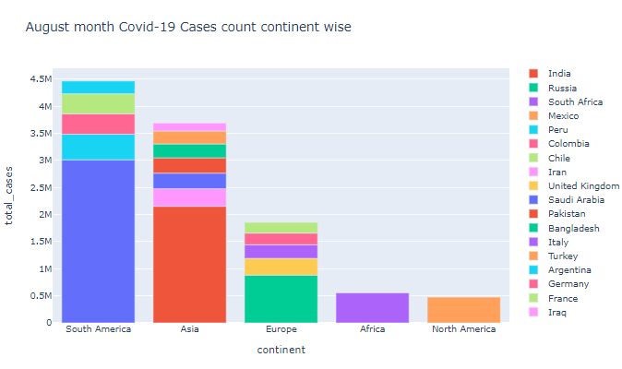
Latest Covid-19 Trend
. Brazil from South America is having almost half of the continent's covid-19 cases (approximately 3 million). The countries which contribute next to Brazil are Peru, Colombia, Chile and Argentina.
Asia is in second having covid-19 infected people almost more than 3.5 million. Same as Brazil, India holds more than half of the continents’ covid-19 infected people (approximately 2.1 million)
.
Europe almost has 1.7 million people infected with covid-19 and Russia has more number. Next United States, Italy, Germany and France having 200K to 300K covid-19 cases.

Slide 9
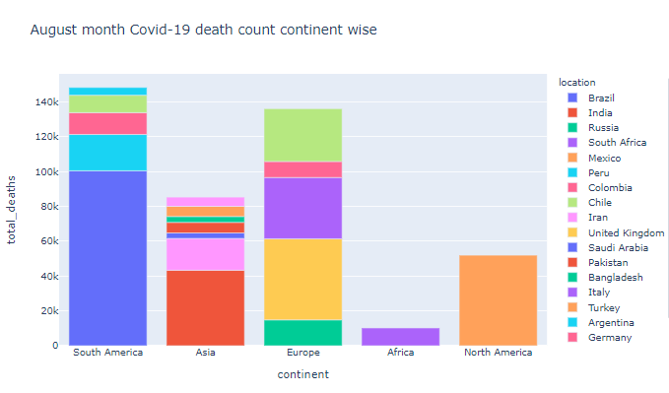
Latest Covid-19 Trend in Deaths
Again South America is having more covid-19 death rate by August 9th, 2020. It almost reached 140K by August 9th, 2020.
Europe is next to South America having almost 135K covid-19 deaths. Covid-19 cases are more in Russia than in United Kingdom but United Kingdom have more death count than Russia.
And Asia has more than 80K deaths in which 50% of death was in India having about 43K deaths.

Slide 10
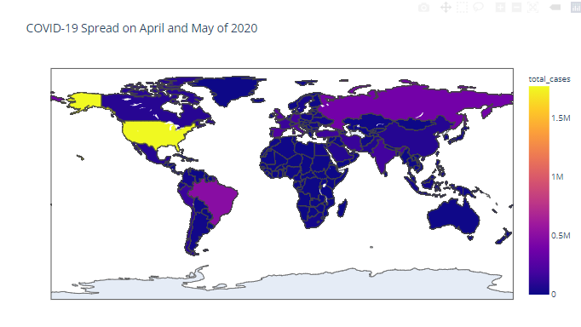
COVID-19 Across the World
In the months of April and May US has more number of cases when compared with rest of the world
India and Iran from Asia, Russia, Germany, Spain, Italy and United Kingdom from Europe and Brazil from South America have COVID-19 infected count in between 0.5million to 1 million.
Oceania and Africa plays a good role in maintain the COVID-19 infected count. Not even a place from Oceania and Africa crossed 0.5million COVID-19 cases.

Slide 11
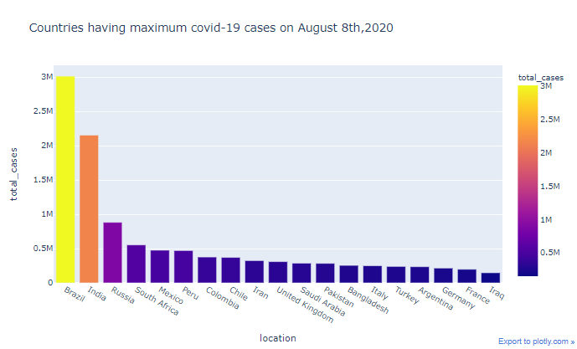
Countries with maximum cases (August, 2020)
Brazil has 3 million covid-19 cases and India has 2.1 million COVID-19 infected cases recorded in August month.
Countries other than these two have less than 1 million covid-19 cases lately.

Slide 12
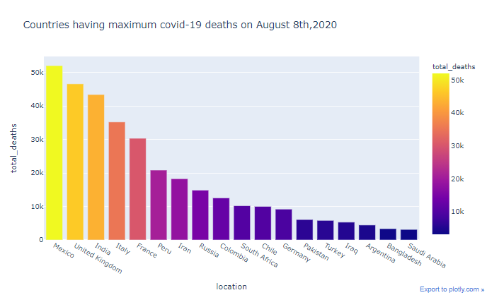
Countries with Max COVID-19 Deaths(August, 2020)
In previous slide we observed that Brazil and India shared the highest position of having covid-19 records.
But Mexico has the higher death rate of about 50K and next to it, United Kingdom holds the second position having 46K deaths recorded in August,2020.

Slide 13
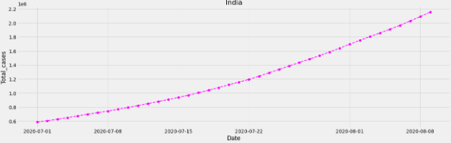
Latest COVID-19 Trend in India(August, 2020)
The covid-19 infected cases curve for India is in an increasing pattern.
This graph shows exact linear trend in the count of infected cases and COVID-19 death follows the same trend.

Slide 14
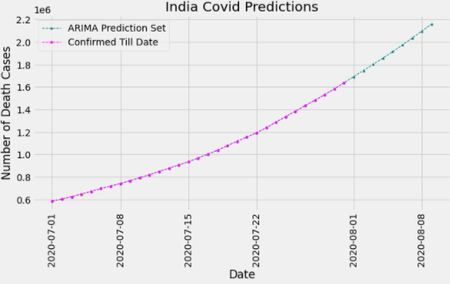
ARIMA predicted Results-India COVID-19
ARIMA model is used to predict the COVID-19 infected cases in India from August 1st,2020 to August 9th, 2020.
The metric used to measure the model performance is AIC.
And the metric value is 522.423

Slide 15
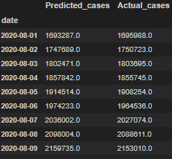
India’s COVID-19 Actual VS Predicted
This is India’s Actual and Predicted COVID-19 infected cases count.
. Lower the AIC value better the model performance.
The p, q and d values passed as argument for ARIMA model are 10, 0 and 2 respectively based on partial auto correlation function and auto correlation function graphs.

Slide 16
Conclusion
Covid-19 has infected over 19 million people worldwide and claimed more than 721K lives with Europe, the United States, Brazil and India overtaking China where the pandemic started last December.
The drastic outbreak spread is influenced by the countries various factors like strictness of lockdown, population density, hygiene and hand washing facilities, smoking population,
COVID-19 is still an unclear infectious disease, which means we can only obtain an accurate ARIMA prediction after the outbreak ends.

